Slide 1
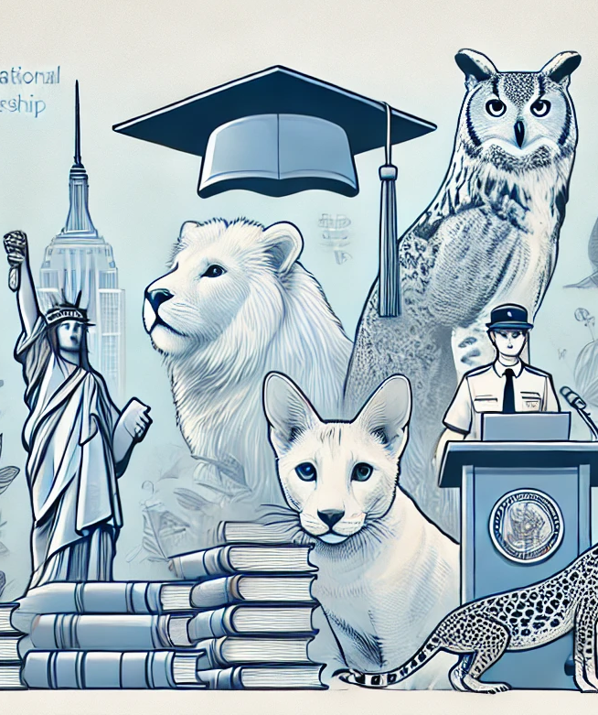
Exploring the Link Between Education and Illegal Pet Ownership in NYC
Yuxuan Geng, PPHA 30538 4, GitHub: emmaa1123
Kohan Chen, PPHA 30538 4, GitHub: kohaningithub
George Wang, PPHA 30538 4, GitHub: gwang613uchi
Notes:
This presentation explores the relationship between education levels and the prevalence of illegal pet ownership in New York City's boroughs.

Slide 2

Our Research Focus
1
Data Exploration
2
Statistical Analysis
Analyzing NYC Open Data and US Census Bureau data on illegal pets and education attainment.
Utilizing regression models to quantify relationships between education levels and incident rates.
3
Policy Insights
Identifying potential policy responses based on key findings and areas for further research.

Slide 3
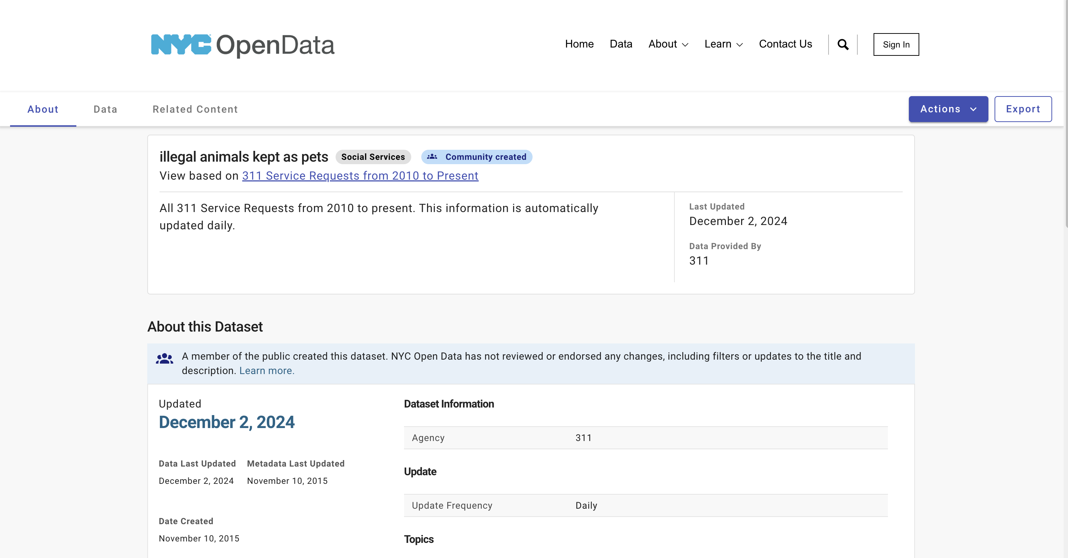
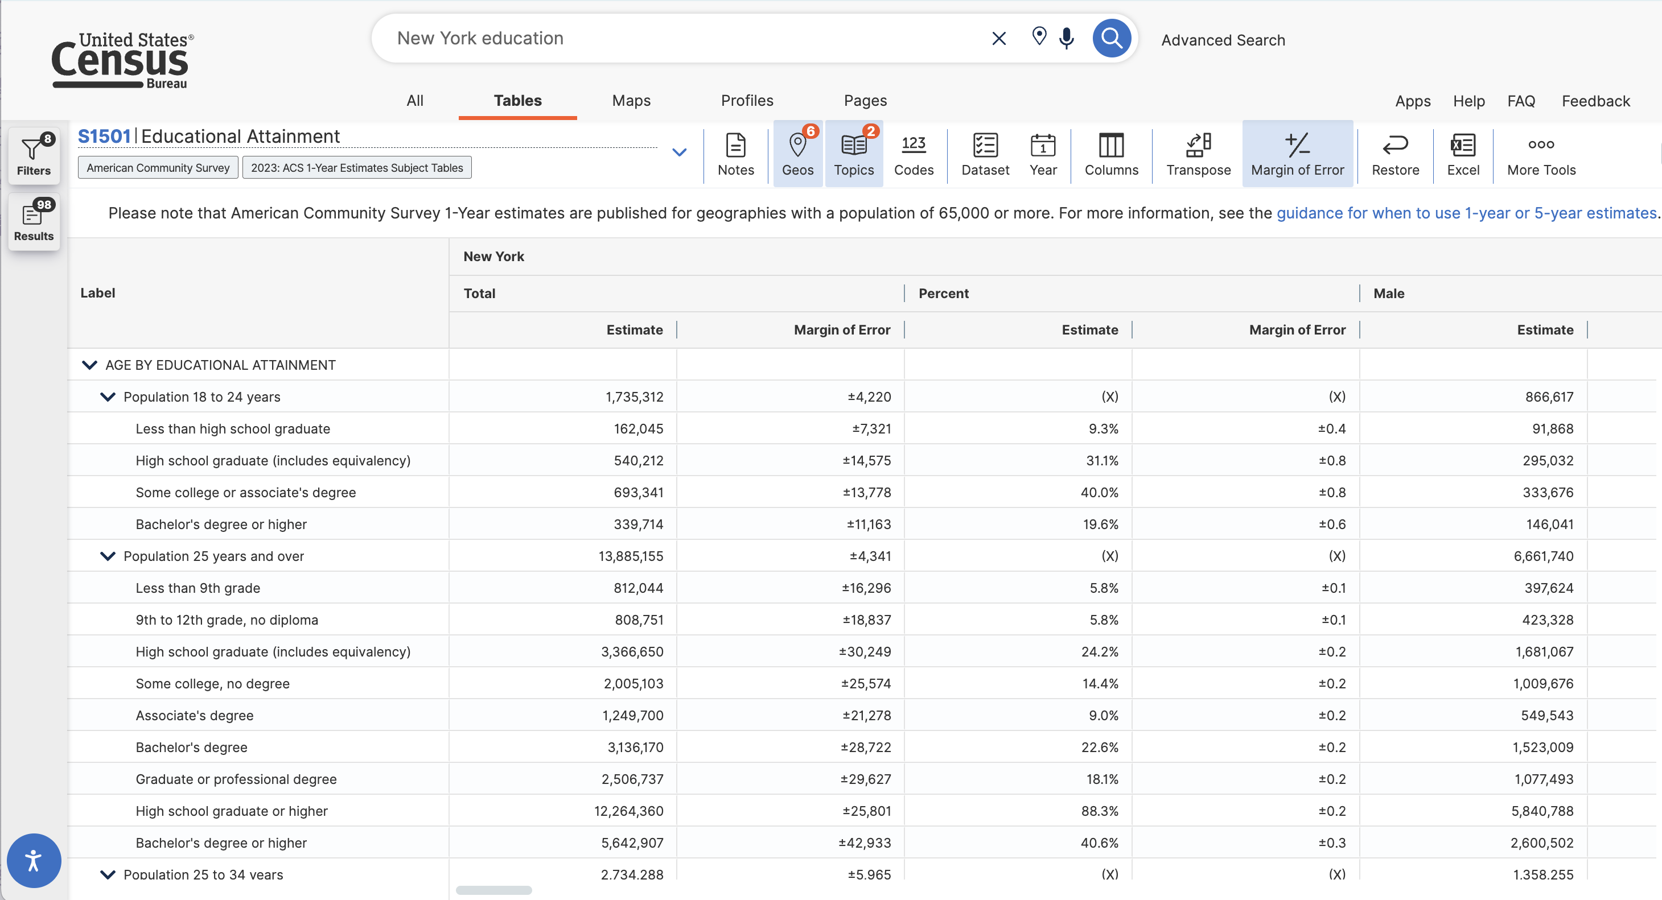
Data Sources
Illegal Pets Data
Education Attainment Data
NYC Open Data: complaint records on illegal pets
US Census Bureau: education levels for NYC boroughs

Slide 4
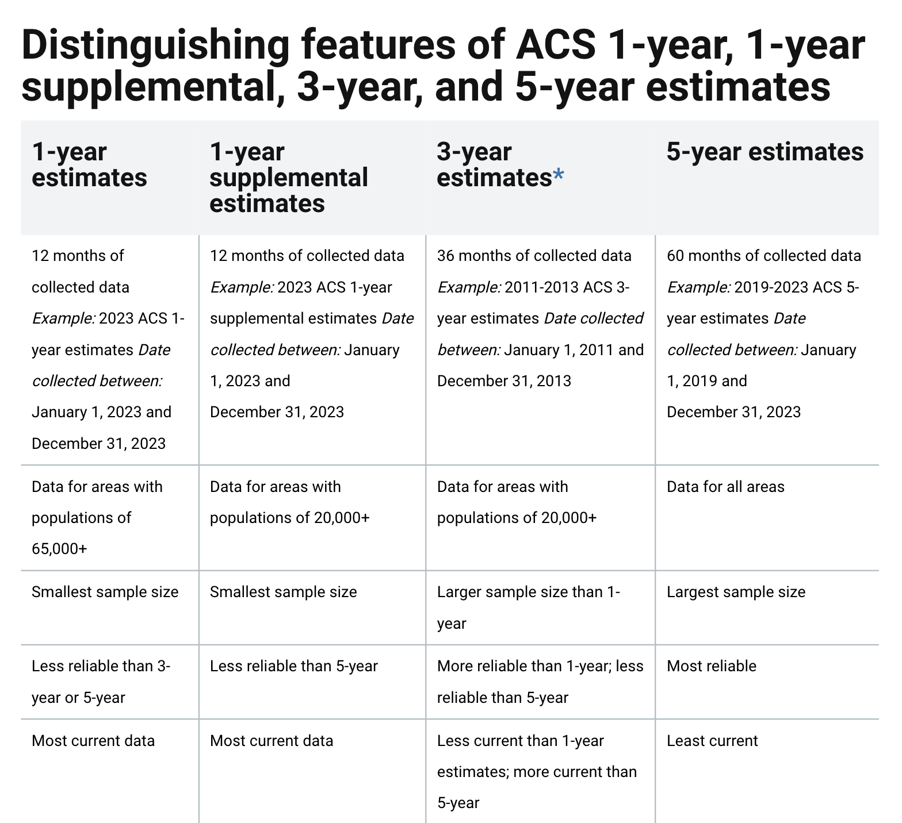
Data Sources
Education Attainment Data
We chose 5-years estimates from 2010 to 2022 because they are the most reliable indicators, though not the most current ones.

Slide 5

Data Cleaning and Standardization
Data Merging
Variable Selection
Incident Normalization
Joining annual education datasets from 2010 to 2022 to annual illegal pet incidents in NYC with time variable (in year format as the key)
Selecting the education attainment of the population aged 25 and older
Selecting variables related to incident locations and illegal pet types to connect the two datasets.
Normalizing incident counts per 10,000 people for fair comparisons because some borough might have higher population and higher incident count.
Notes:
Data Merging:
- Different time variable across two datasets (need to convert them to the same YEAR format)
Variable Selection:
25+ years old: common practice for education analysis because most people have finished their education, making it representative
2010 – 2014,
Incident Normalization:
Both education and illegal pet use percentage

Slide 6
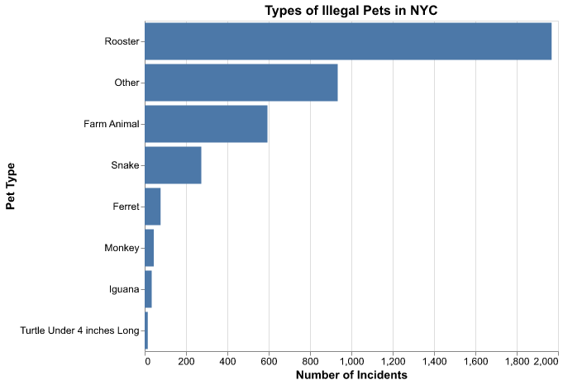
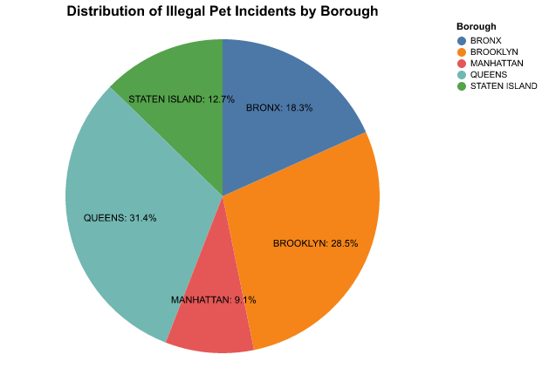
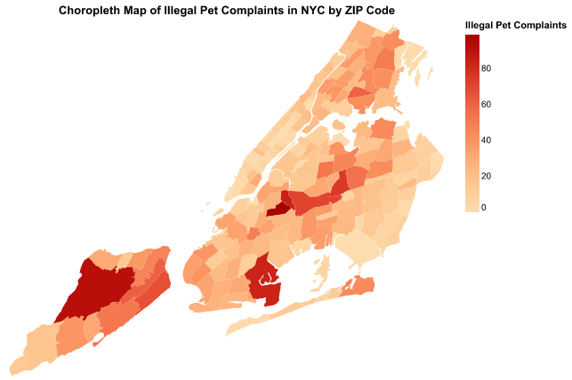
Visualizations
Types of Illegal Pets
Distribution of Illegal Pet Incidents
Spatial Patterns of Incidents
A bar chart reveals roosters as the most common illegal pet type.
Pie chart highlights the geographic distribution of incidents, with Brooklyn and Queens leading in complaint counts, reflecting their population density.
Choropleth map shows ZIP-level variability in illegal pet complaints, highlighting dense clusters.
Notes:
Why do visualizations separately?
- Want to keep the granularity of illegal pets, which is more meaningful to keep zip-code-level visualization
Illegal pets lacks data entries every year, so we did not perform incident over years
Bar chart:
B and Q have the most incidents and the most population among districts
THUS, we use the incident rate, not the incident count

Slide 7
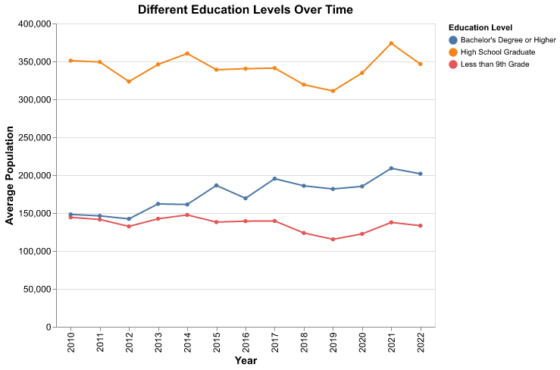
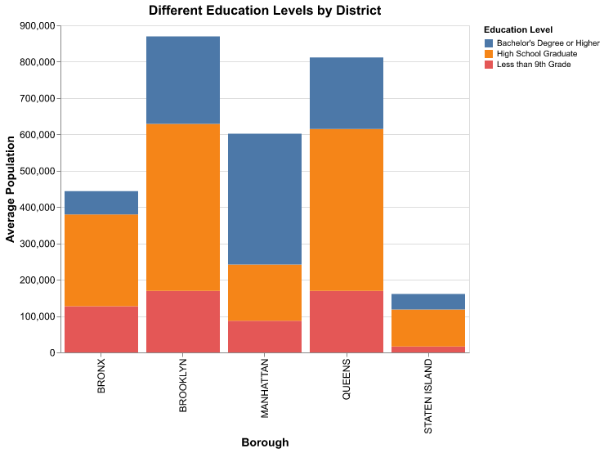
Visualizations
Education Attainment Trend
Education Levels by Borough
Line plot illustrates trends in educational attainment (e.g., high school graduates, bachelor’s degrees) over the study period
Bar chart highlights uneven distribution of bachelor degree holders among borough, with Manhattan leading in the total share
Notes:
- Line plot:
High school graduate and bachelor increase over time, but less than 9th grade does not
High school graduate is the majority

Slide 8
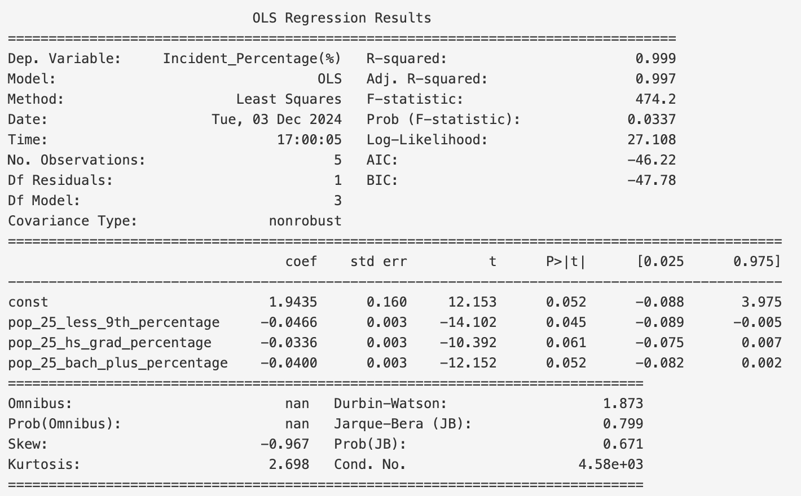
Regression Analysis Results
-0.0466
Less than 9th Grade
Negative correlation between education level and incident rate.
-0.0336
High School Graduates
Slight negative correlation between education level and incident rate.
-0.0400
Bachelor's Degree
Negative correlation between education level and incident rate.
Notes:
Report coefficients
Confirm p values
Small coefficient because 1) very few people have illegal pets 2) due to scaling effect
Not enough observations, leading to unrobust regression analysis (need more data in the future)

Slide 9
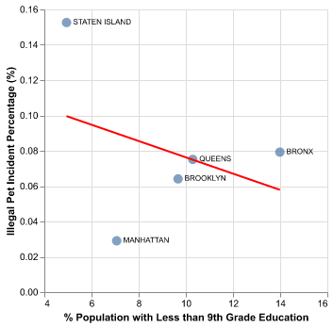
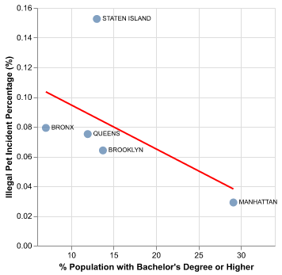
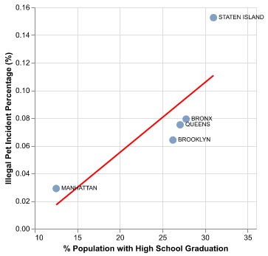
Regression Analysis Results
-0.0466
-0.0336
-0.0400
Less than 9th Grade
High School Graduates
Bachelor's Degree
Notes:
Emphasize scaling effect (why distortional slope)
Staten Islan above our prediction
The most southern district: people lean to have illegal pets
Less urban than other districts so it has lower education and less enforcement
Simply because of scaling effect (difference is not significant perhaps)
Despite its limitations, this method offers a useful framework for understanding the relationship between educational
attainment percentage and illegal pet incidents in NYC. By normalizing data and employing regression analysis, the
study provides insights that can inform policy decisions and highlight areas for further research. The visualizations
effectively communicate complex data, making it accessible to a wider audience and supporting informed decision-
making.

Slide 10
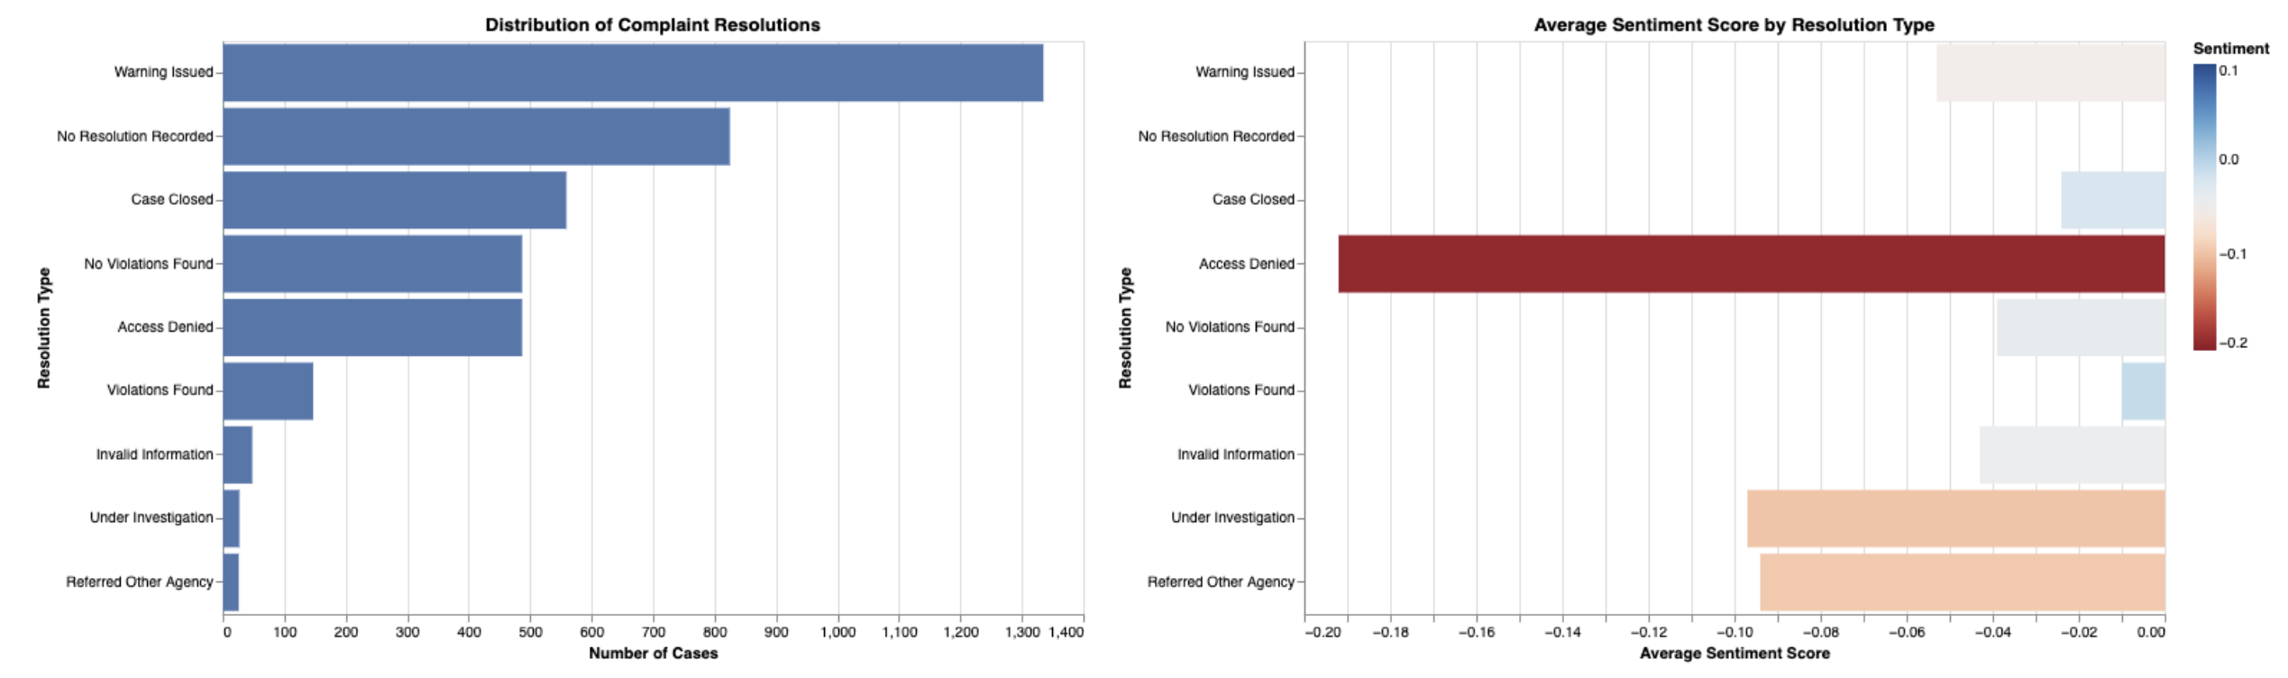
NLP Sentiment and Resolution Analysis
"Warning Issued"
Most common resolution
"Access Denied"
Most negative tone
Slightly Negative
to Neutral
Overall tone
reflecting a professional yet firm communication style
Notes:
“Violoation Found” is the most neutral
Although all negative values suggest negative sentiment, the official communication style is consistent.
Though it is a document with official language, there are many categories with similar complaint resolutions. Thus, we use TF-IDF to standardize all similar resolution type automatically.
We applied sentiment analysis to understand the emotional tone in resolution descriptions of illegal pet complaints. Using TextBlob, we scored text from -1 (negative) to +1 (positive), with 0 being neutral, to understand how different outcomes are communicated. Key findings include “Warning Issued” as most common resolution, and “Access Denied” as the most negative tone. Overall trend is slightly negative to neutral tone across most categories. The analysis reveals that while most communications maintain a professional, slightly negative tone, failed inspection attempts (“Access Denied”) are communicated more negatively. This suggests a consistent official communication style with variations based on resolution outcome.
Also, for the Resolution distribution analysis, text descriptions are converted to numerical vectors using TF-IDF, then matched to categories using cosine similarity, enabling automated and consistent classification of resolution types. It shows a preference for issuing warnings (34%) over finding violations, though a concerning 21% lack recorded resolutions. “Access Denied”: Access to inspection sites remains a notable challenge.

Slide 11
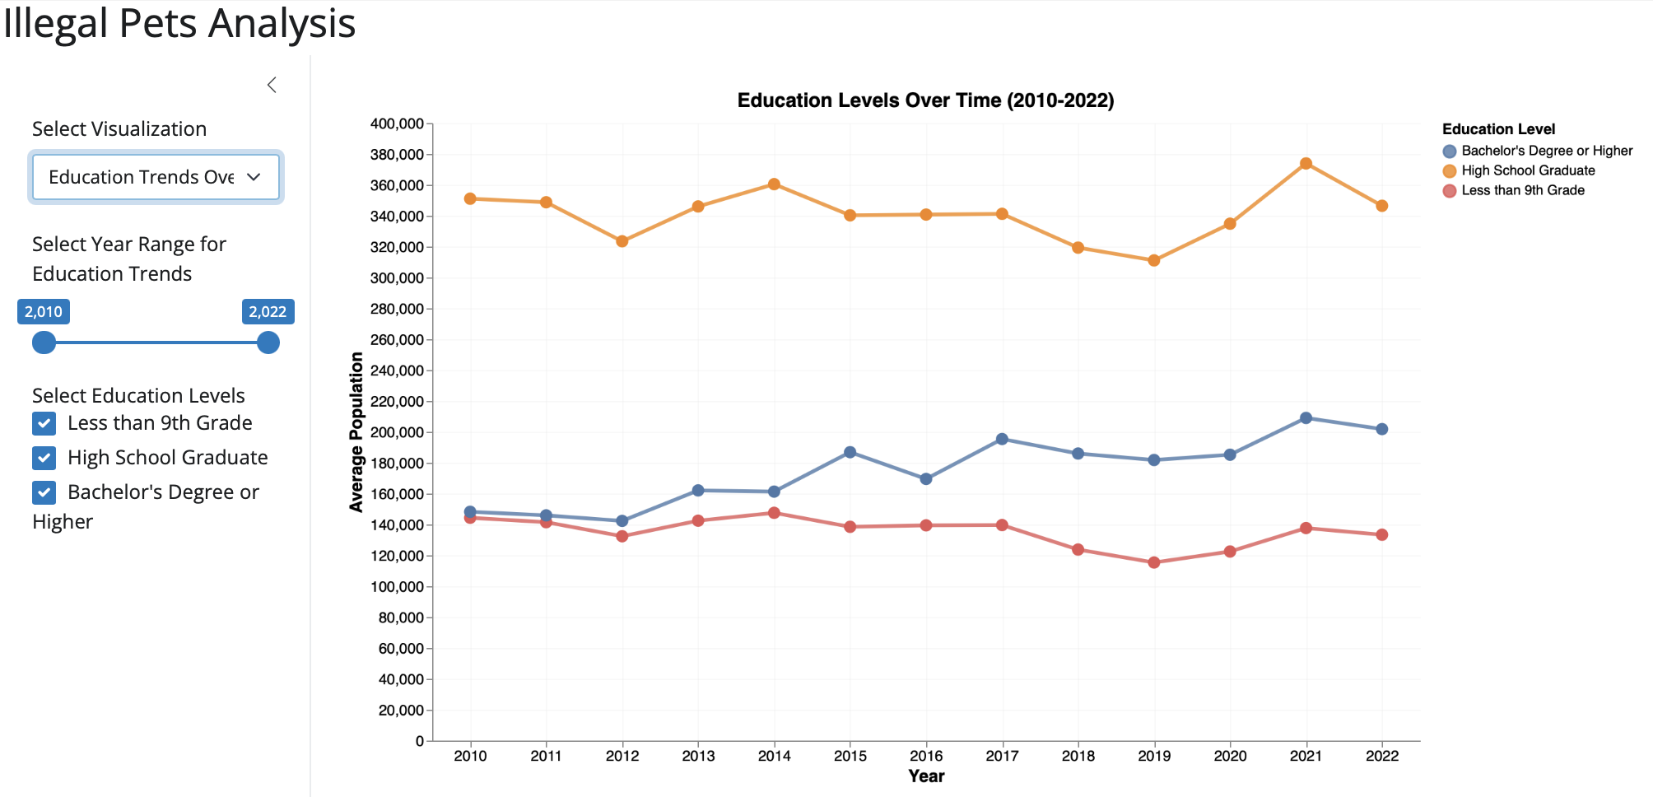
Shiny App with Interactions
With interactive toggles and checkboxes, range sliders, dropdown menu, and range slider, users can filter data by specific years, year ranges, or education levels. These features allow them to explore the spatial and socioeconomic factors affecting illegal pet incidents.

Slide 12



Key Findings and Limitations
Minimal Influence
1
Weak correlations between education and illegal pet ownership.
Borough Variability
2
Staten Island exhibits higher-than-predicted incident rates.
Spatial Clusters
3
ZIP-level analysis highlights areas with dense complaint clusters, not evenly distributed
Notes:
Weak correlation:
it is more about the public engagement, not about education level
People simply don’t know about which illegal animal cannot keep

Slide 13
Policy Implications and Next Steps
Community Outreach
1
Educational campaigns in high-incident areas.
Enhanced Enforcement
2
Strengthening enforcement in areas with dense clusters to avoid ”access denied” problem.
Interactive Tools
3
Developing tools to engage the public and policymakers.

Slide 14

Future Directions for Research
Neighborhood-Level Data
Illegal Pets Type
Examining localized trends and variations of education.
Examining the popularity of certain illegal pets type (rooster, snake, etc.)
1
2
3
Socioeconomic Factors
Exploring income, housing, and cultural influences.
Notes:
Educational Purpose:
Inform the public about illegal pet type

